Slide 1


K.RAMAKRISHNAN COLLEGE OF TECHNOLOGY
(AUTONOMOUS), TRICHY.
BRICK BREAKER GAME
PRESENTED
AFIYA J
2303811710422004
SUPERVISOR
Mr. M. Saravanan, M.E.,
AP/CSE.

Slide 2
PRESENTATION OVERVIEW
Objective
Project Introduction
Problem Statement
Methodologies (Programming concepts relevant to problem statement)
Architecture of the proposed system
List of Modules
Merits
Results and Discussion
Queries

Slide 3
OBJECTIVE
To design and implement an engaging arcade-style Brick Breaker game using Java, demonstrating core programming concepts such as object-oriented design, event handling, and graphical user interface development with the Swing framework.
To provide a hands-on learning experience in game development, focusing on collision detection, real-time animations, and dynamic gameplay mechanics

Slide 4
PROJECT INTRODUCTION
The Advanced Brick Breaker Game is an arcade-style project developed in Java using the Swing framework. It involves a paddle controlled by the player, a bouncing ball, and a grid of bricks to break, with the objective of clearing all bricks while avoiding ball drops.
This project demonstrates key programming concepts like object-oriented design, event-driven control, collision detection, and graphical animations.
It serves as a fun and practical way to learn game development while showcasing Java’s capabilities in creating interactive applications.

Slide 5
PROBLEM STATEMENT
To create a dynamic and interactive arcade game that demonstrates the practical application of programming concepts such as object-oriented design, event handling, and graphical user interface development using Java.
The project addresses the need for a fun and engaging way to learn and apply Java skills while overcoming challenges in real-time collision detection, animation rendering, and user interaction in game development.

Slide 6
METHODOLOGIES
Object-Oriented Programming (OOP): Key game elements like the paddle, ball, and bricks are represented using variables and logical structures, adhering to OOP principles.
Event-Driven Programming : The game relies on user inputs (arrow keys) to control the paddle, handled through Java's event-listener mechanism (KeyAdapter).
Component-Based Development : The game components such as the ball, paddle, and bricks are developed as modular elements
Graphical User Interface (GUI) Programming: The game uses the Swing framework for rendering graphics and animations. The paintComponent method is employed to draw game components dynamically.
Collision Detection Logic: Logical checks and Java's Rectangle2D class are used for detecting collisions between the ball, paddle, bricks, and screen boundaries.

Slide 7
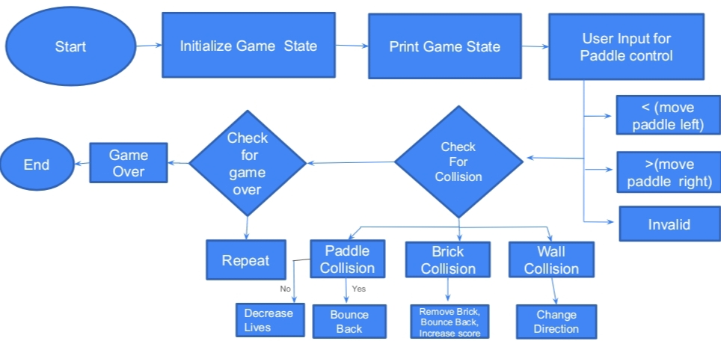
ARCHITECTURE OF THE PROPOSED SYSTEM

Slide 8
LIST OF MODULES
MODULE DESCRIPTON
Game Initialization Module:
Sets up the game environment, including the GUI, layout, and initial states of the ball, paddle, and bricks. Initializes variables like score, lives, and timers to prepare the game for execution.
Ball Module:
Handles the ball's movement, speed, and direction, ensuring proper collision with the paddle, bricks, and screen boundaries. Manages the ball's position updates and bounces during gameplay.
Paddle Module:
Controls the player's paddle, allowing movement using keyboard inputs. Ensures the paddle remains within screen boundaries and interacts with the ball effectively.

Slide 9
LIST OF MODULES
MODULE DESCRIPTON
Brick Module:
Represents the grid of bricks, tracking their visibility and status. Manages brick removal upon collision with the ball and contributes to the player's score.
Game Logic and Control Module:
Oversees the overall game flow, including collision detection, score updates, life tracking, and game-over conditions. Synchronizes the components and ensures smooth, real-time gameplay through event handling.
2/7/20

Slide 10
MERITS
Practical Learning: Demonstrates core Java concepts like object-oriented programming, event handling, and GUI development.
Interactive Gameplay: Provides an engaging experience with real-time interactions and dynamic animations.
Modular Design: Organized into separate modules (ball, paddle, bricks, etc.), ensuring scalability and maintainability.
Portability: Developed in Java, making it platform-independent and easily executable on multiple systems.
Engages Creativity: Encourages innovation through designing levels, visual styles, and gameplay improvements.

Slide 11
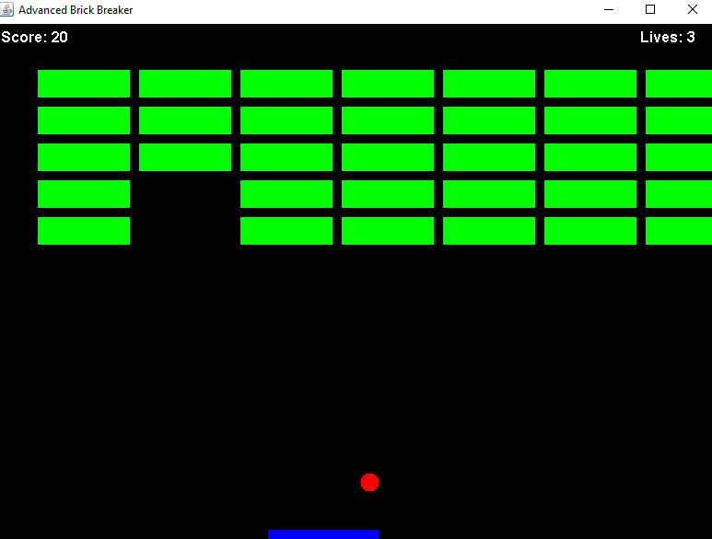
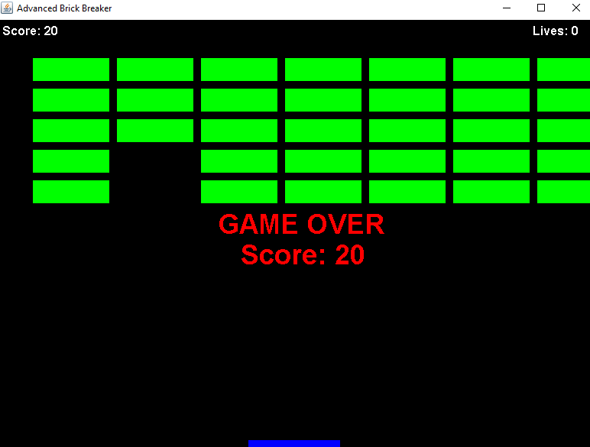
RESULTS AND DISCUSSION

Slide 12
QUERIES ?

